Slide 1
Unit 3 Supervised learning capstone project
File name: Project 3.7.1-Unit 3 Capstone Project

Slide 2
Research question:
Can the house prices be predicted accurately based on various features of the house and its location or context ?
We also want to know some explanatory power of these features in determining the value of the houses
Should benefit the Real Estate developer in knowing what features/context will increase the value of the house

Slide 3
Presentation overview
DATA
Data Cleaning
DATA
Data Exploration
Includes=[Correlations, Bivariate]
Feature
What are important features?
Includes=[Removing outliers, Null, Imputation]
Feature selection and Creating features
Final prep
Scaling
Splitting data
Model
Choosing parameters
Evaluation metrics
Practical use
Prediction
Features adding Value to Home
Short
comings
Error improvement

Slide 4
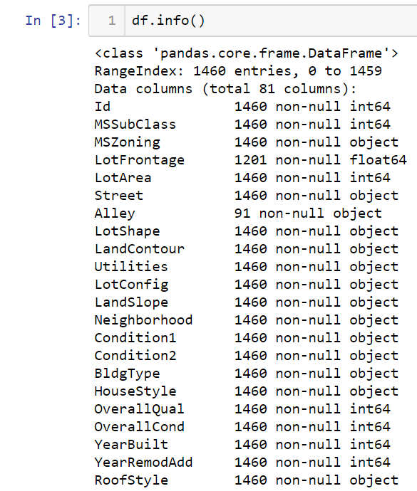
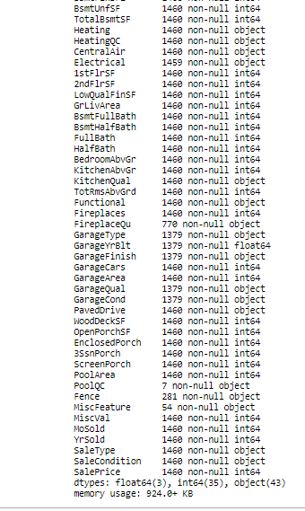
Source = https://www.kaggle.com/c/house-prices-advanced-regression-techniques/data
Data Cleaning
Includes=[Removing outliers, Null, Imputation]

Slide 5
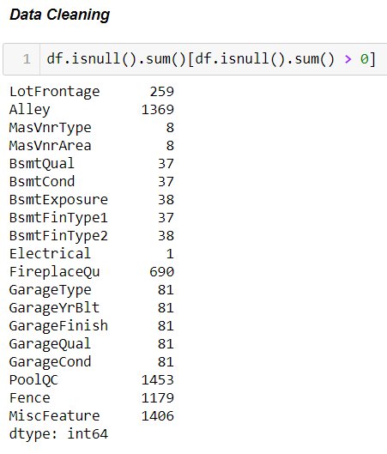

Slide 6
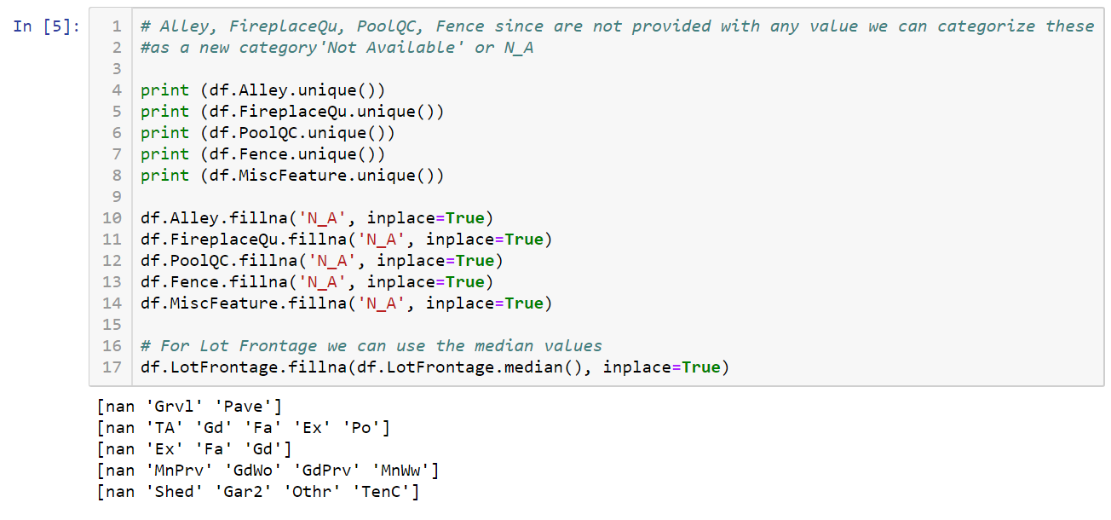
Data Cleaning
Includes=[Removing outliers, Null, Imputation]

Slide 7
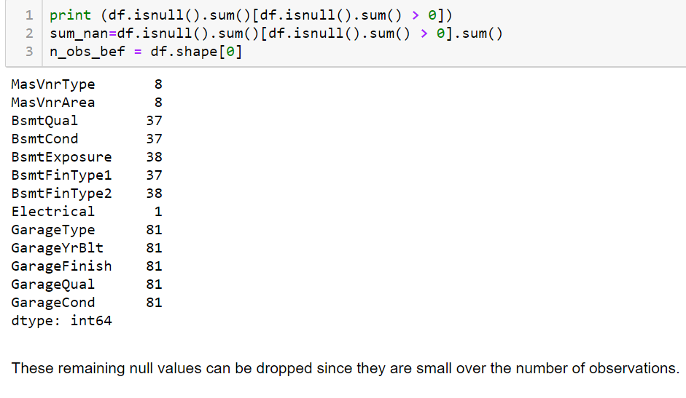
Data Cleaning
Includes=[Removing outliers, Null, Imputation]
Only 122 rows dropped to remove a
total of 609 NaNs

Slide 8
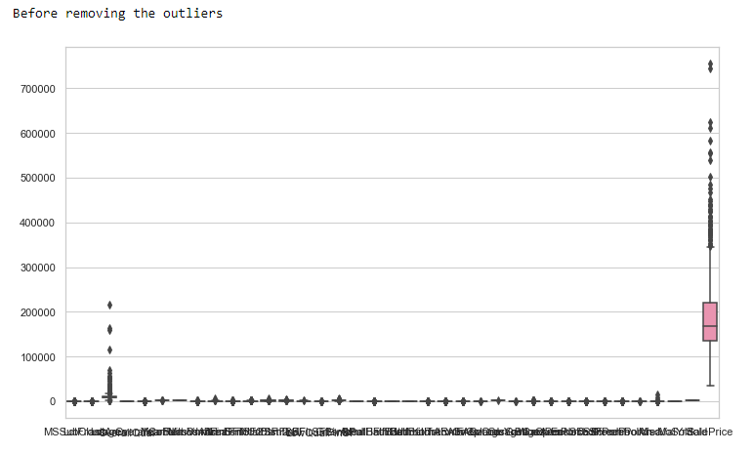
Data Cleaning
Includes=[Removing outliers, Null, Imputation]
for columns in df:
stats.mstats.winsorize(df[columns], inplace=True, limits = [0.05, 0.05])

Slide 9
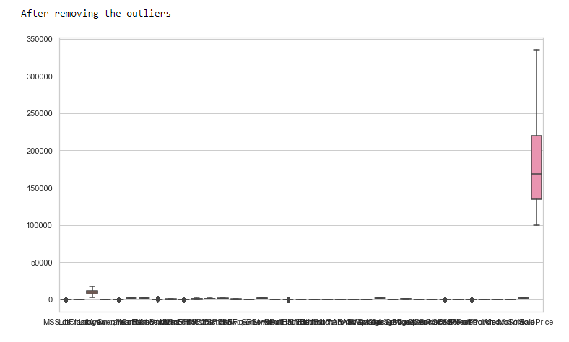

Slide 10
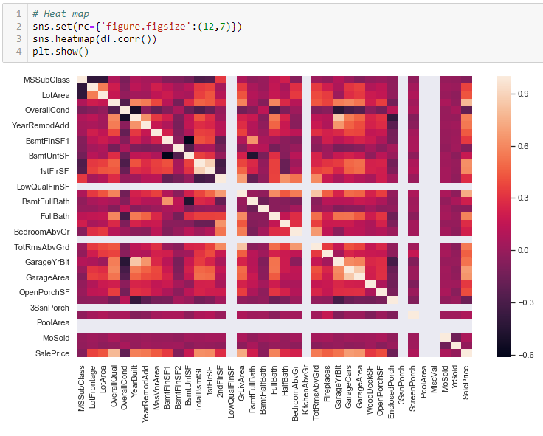
Data Exploration
Includes=[Correlations, Bivariate]

Slide 11
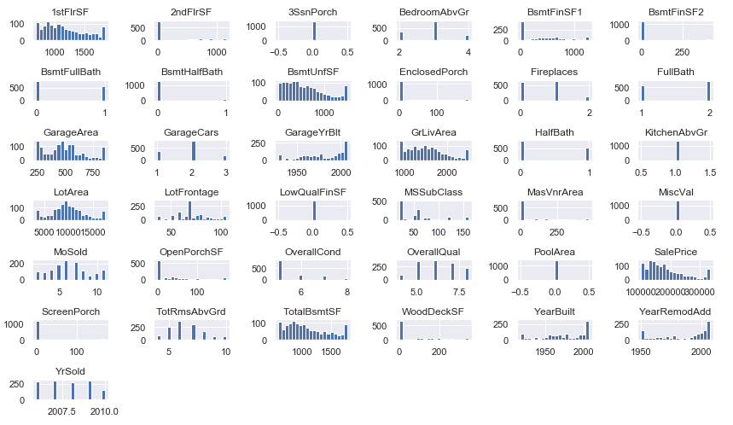

Slide 12
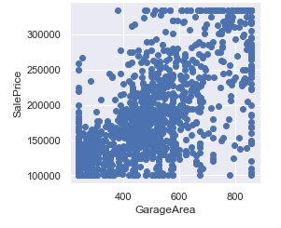
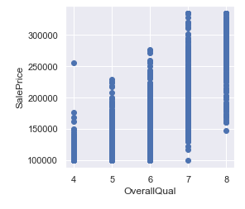
Data Exploration
Includes=[Correlations, Bivariate]

Slide 13
What are important features?
Feature selection and Creating features

Slide 14
Technical problem encountered
Need to make Dummy Variables/Binary indicators for only Categorical variables
These categorical variables can be of two types:
String ---simple…use select_dtypes…include=[‘Categorical’]---includes only string type
Integers ? ? ? ? ?
Solutions:
Tried include and exclude options…but couldn’t find the correct combination
Wrote my own code for selecting only discontinuous or integer categorical variables.

Slide 15
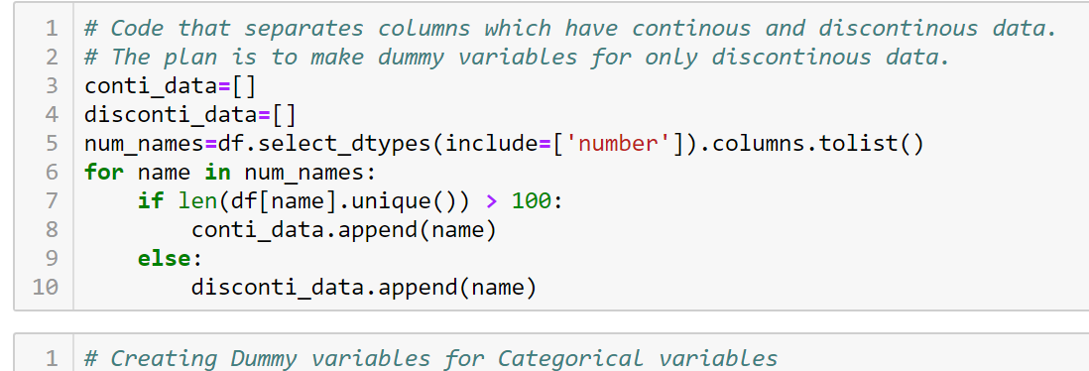

Slide 16
Scaling
Splitting data
df1=pd.DataFrame(preprocessing.scale(df[num_names]), columns=num_names)
global X_train, X_test, y_train, y_test
X_train, X_test, y_train, y_test = train_test_split(X, Y, test_size=0.33, random_state=1)

Slide 17
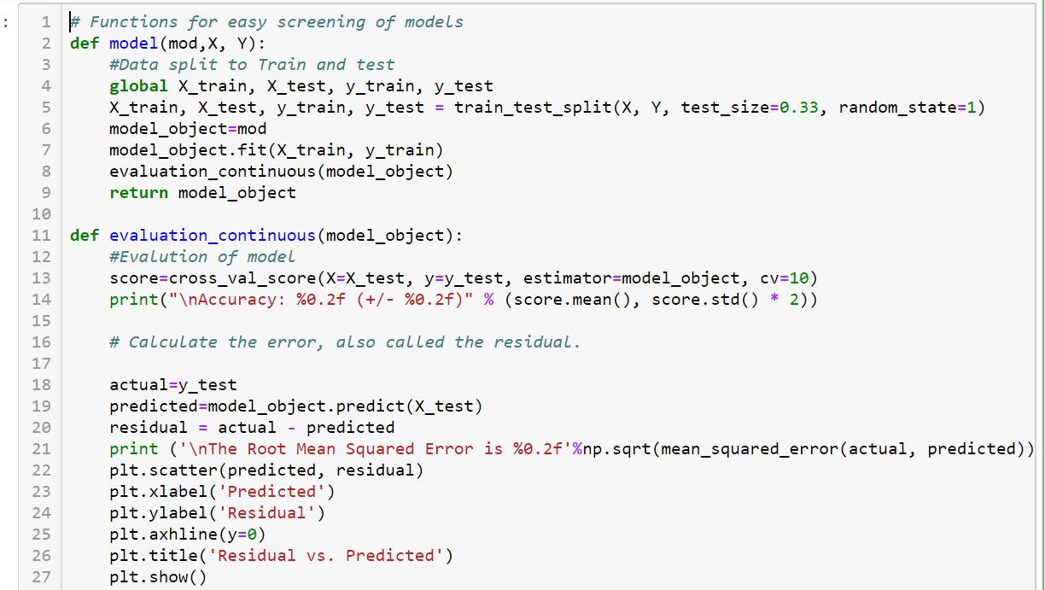
Choosing parameters
Evaluation metrics

Slide 18
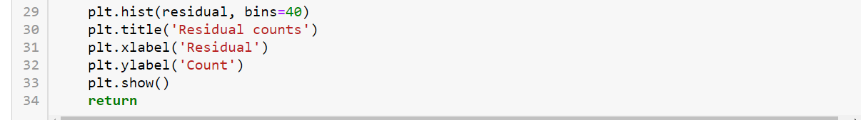
Random Forest regression
model(ensemble.RandomForestRegressor(), X, Y)
RandomForestRegressor(bootstrap=True, criterion='mse', max_depth=None,
max_features='auto', max_leaf_nodes=None,
min_impurity_decrease=0.0, min_impurity_split=None,
min_samples_leaf=1, min_samples_split=2,
min_weight_fraction_leaf=0.0, n_estimators=10, n_jobs=None,
oob_score=False, random_state=None, verbose=0, warm_start=False)

Slide 19
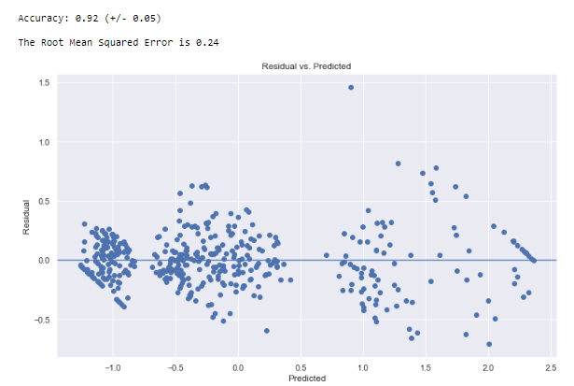
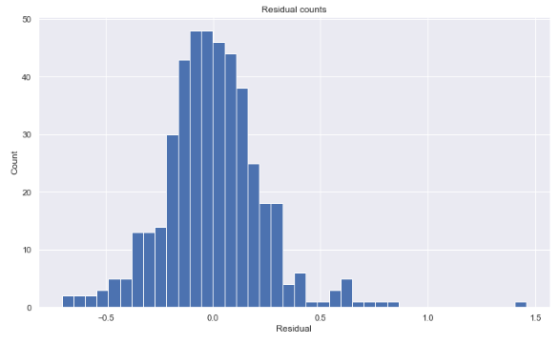
Random Forest results

Slide 20
Ridge regression model
Ridge(alpha=1.0, copy_X=True, fit_intercept=True, max_iter=None,
normalize=False, random_state=None, solver='auto', tol=0.001)
model(linear_model.Ridge(), X, Y)

Slide 21
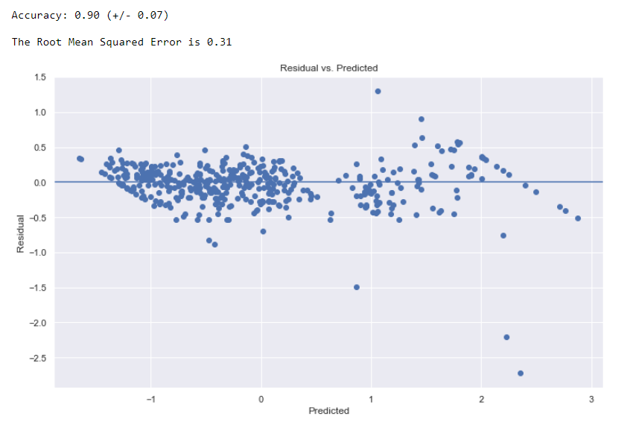
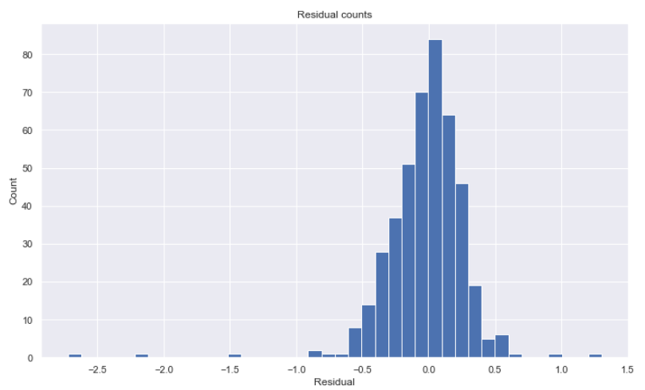
Ridge regression model

Slide 22
Lasso Regression
model(linear_model.Lasso(alpha=0.001), X, Y)
Lasso(alpha=0.001, copy_X=True, fit_intercept=True, max_iter=1000,
normalize=False, positive=False, precompute=False, random_state=None,
selection='cyclic', tol=0.0001, warm_start=False)

Slide 23

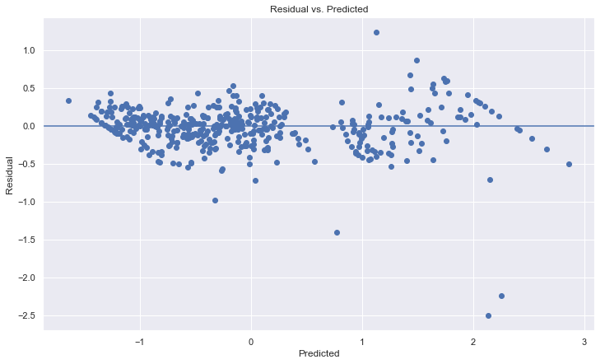
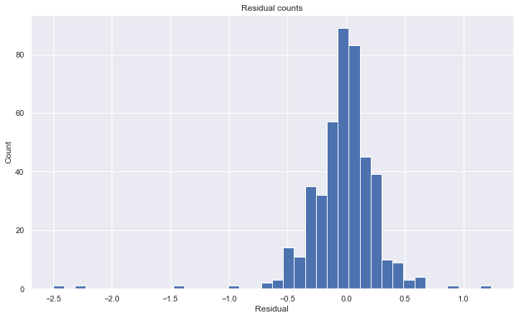
Lasso regression

Slide 24
Gradient Boost Regression
params = {'n_estimators': 500,
'max_depth': 2}
model(ensemble.GradientBoostingRegressor(**params), X, Y)
GradientBoostingRegressor(alpha=0.9, criterion='friedman_mse', init=None,
learning_rate=0.1, loss='ls', max_depth=2, max_features=None,
max_leaf_nodes=None, min_impurity_decrease=0.0,
min_impurity_split=None, min_samples_leaf=1,
min_samples_split=2, min_weight_fraction_leaf=0.0,
n_estimators=500, n_iter_no_change=None, presort='auto',
random_state=None, subsample=1.0, tol=0.0001,
validation_fraction=0.1, verbose=0, warm_start=False)

Slide 25

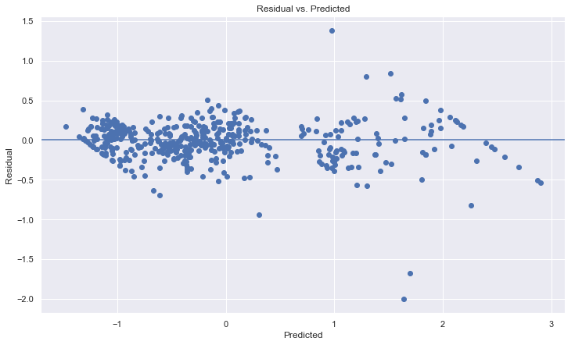
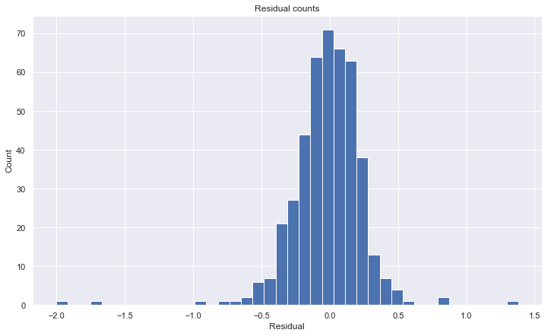
Gradient Boost Regression

Slide 26
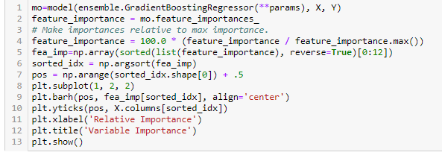
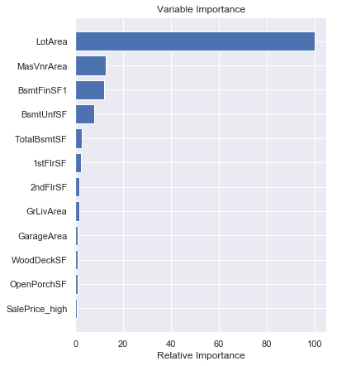
Gradient boost regression

Slide 27
Short comings of the model
One major short coming is the presence of Root Mean squared error of 0.24.
A few points wrongly predicted as seen in the Residual plot caused the error to go high. Need to figure out how to reduce the error as future work to this.

Slide 28
conclusions
As suggested by the Gradient boost model listed the top 12 features needed for a real estate developer to add value to a house and also predictive of the prices of house.
Random Forest Regression successfully predicted the house prices with the highest accuracy of 93% and Gradient Boost Regression model has the next highest with 92% accuracy
In terms of the lowest error Random Forest Regression model has the lowest error of 0.24 compared to all other regression models.

